Slide 1
William Stallings
Computer Organization and Architecture
8th Edition
Chapter 10
Instruction Sets:
Characteristics and Functions

Slide 2
What is an Instruction Set?
The complete collection of instructions that are understood by a CPU
Machine Code
Binary
Usually represented by assembly codes
Notes:
2

Slide 3
Elements of an Instruction
Operation code (Op code)
  Do this
Source Operand reference
  To this
Result Operand reference
  Put the answer here
Next Instruction Reference
  When you have done that, do this...
Notes:
3

Slide 4
Where have all the Operands Gone?
Long time passing….
(If you don’t understand, you’re too young!)
Main memory (or virtual memory or cache)
CPU register
I/O device
Notes:
4

Slide 5
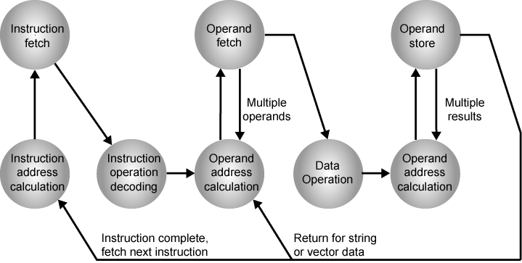
Instruction Cycle State Diagram

Slide 6
Instruction Representation
In machine code each instruction has a unique bit pattern
For human consumption (well, programmers anyway) a symbolic representation is used
  e.g. ADD, SUB, LOAD
Operands can also be represented in this way
  ADD A,B
Notes:
5

Slide 7
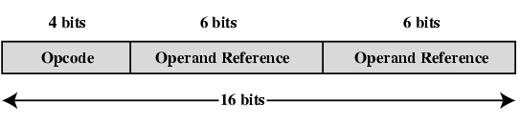
Simple Instruction Format

Slide 8
Instruction Types
Data processing
Data storage (main memory)
Data movement (I/O)
Program flow control
Notes:
6

Slide 9
Number of Addresses (a)
3 addresses
  Operand 1, Operand 2, Result
  a = b + c;
  May be a forth - next instruction (usually implicit)
  Not common
  Needs very long words to hold everything
Notes:
7

Slide 10
Number of Addresses (b)
2 addresses
  One address doubles as operand and result
  a = a + b
  Reduces length of instruction
  Requires some extra work
    Temporary storage to hold some results
Notes:
8

Slide 11
Number of Addresses (c)
1 address
  Implicit second address
  Usually a register (accumulator)
  Common on early machines
Notes:
9

Slide 12
Number of Addresses (d)
0 (zero) addresses
  All addresses implicit
  Uses a stack
  e.g. push a
  push b
  add
  pop c
  c = a + b
Notes:
10

Slide 13
How Many Addresses
More addresses
  More complex (powerful?) instructions
  More registers
    Inter-register operations are quicker
  Fewer instructions per program
Fewer addresses
  Less complex (powerful?) instructions
  More instructions per program
  Faster fetch/execution of instructions
Notes:
11

Slide 14
Design Decisions (1)
Operation repertoire
  How many ops?
  What can they do?
  How complex are they?
Data types
Instruction formats
  Length of op code field
  Number of addresses
Notes:
12

Slide 15
Design Decisions (2)
Registers
  Number of CPU registers available
  Which operations can be performed on which registers?
Addressing modes (later…)
RISC v CISC
Notes:
13

Slide 16
Types of Operand
Addresses
Numbers
  Integer/floating point
Characters
  ASCII etc.
Logical Data
  Bits or flags
(Aside: Is there any difference between numbers and characters? Ask a C programmer!)
Notes:
14

Slide 17
x86 Data Types
8 bit Byte
16 bit word
32 bit double word
64 bit quad word
128 bit double quadword
Addressing is by 8 bit unit
Words do not need to align at even-numbered address
Data accessed across 32 bit bus in units of double word read at addresses divisible by 4
Little endian
Notes:
15

Slide 18
SMID Data Types
Integer types
  Interpreted as bit field or integer
Packed byte and packed byte integer
  Bytes packed into 64-bit quadword or 128-bit double quadword
Packed word and packed word integer
  16-bit words packed into 64-bit quadword or 128-bit double quadword
Packed doubleword and packed doubleword integer
  32-bit doublewords packed into 64-bit quadword or 128-bit double quadword
Packed quadword and packed qaudword integer
  Two 64-bit quadwords packed into 128-bit double quadword
Packed single-precision floating-point and packed double-precision floating-point
  Four 32-bit floating-point or two 64-bit floating-point values packed into a 128-bit double quadword
Notes:
16

Slide 19
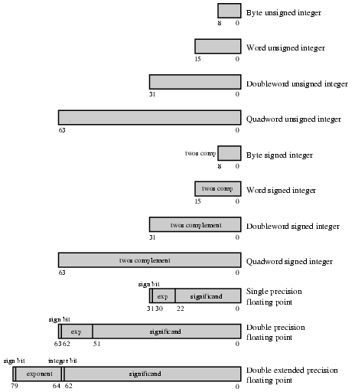
x86 Numeric Data Formats
Notes:
17

Slide 20
ARM Data Types
8 (byte), 16 (halfword), 32 (word) bits
Halfword and word accesses should be word aligned
Nonaligned access alternatives
  Default
    Treated as truncated
    Bits[1:0] treated as zero for word
    Bit[0] treated as zero for halfword
    Load single word instructions rotate right word aligned data transferred by non word-aligned address one, two or three bytesAlignment checking
  Data abort signal indicates alignment fault for attempting unaligned access
  Unaligned access
  Processor uses one or more memory accesses to generate transfer of adjacent bytes transparently to the programmer
Unsigned integer interpretation supported for all types
Twos-complement signed integer interpretation supported for all types
Majority of implementations do not provide floating-point hardware
  Saves power and area
  Floating-point arithmetic implemented in software
  Optional floating-point coprocessor
  Single- and double-precision IEEE 754 floating point data types

Slide 21
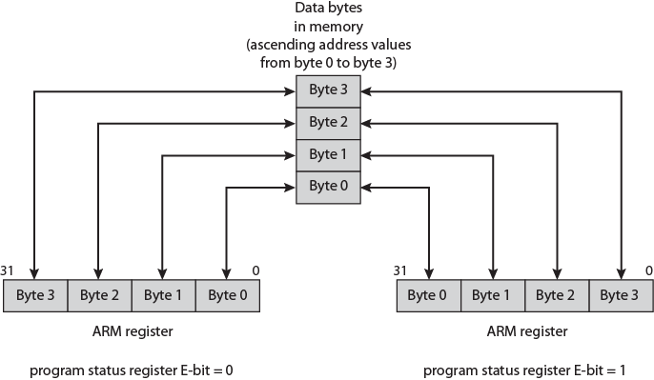
ARM Endian Support
E-bit in system control register
Under program control

Slide 22
Types of Operation
Data Transfer
Arithmetic
Logical
Conversion
I/O
System Control
Transfer of Control
Notes:
18

Slide 23
Data Transfer
Specify
  Source
  Destination
  Amount of data
May be different instructions for different movements
  e.g. IBM 370
Or one instruction and different addresses
  e.g. VAX
Notes:
19

Slide 24
Arithmetic
Add, Subtract, Multiply, Divide
Signed Integer
Floating point ?
May include
  Increment (a++)
  Decrement (a--)
  Negate (-a)
Notes:
20

Slide 25
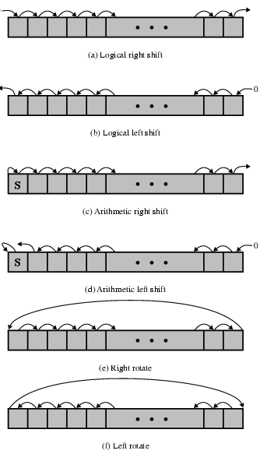

Shift and Rotate Operations

Slide 26
Logical
Bitwise operations
AND, OR, NOT
Notes:
21

Slide 27
Conversion
E.g. Binary to Decimal
Notes:
22

Slide 28
Input/Output
May be specific instructions
May be done using data movement instructions (memory mapped)
May be done by a separate controller (DMA)
Notes:
23

Slide 29
Systems Control
Privileged instructions
CPU needs to be in specific state
  Ring 0 on 80386+
  Kernel mode
For operating systems use
Notes:
24

Slide 30
Transfer of Control
Branch
  e.g. branch to x if result is zero
Skip
  e.g. increment and skip if zero
  ISZ Register1
  Branch xxxx
  ADD A
Subroutine call
  c.f. interrupt call
Notes:
25

Slide 31
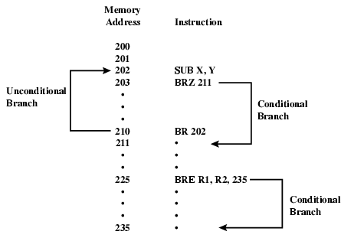
Branch Instruction

Slide 32
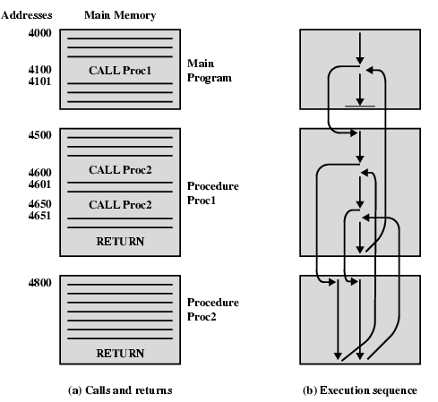
Nested Procedure Calls

Slide 33
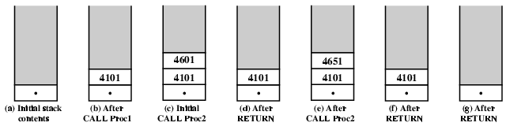
Use of Stack

Slide 34
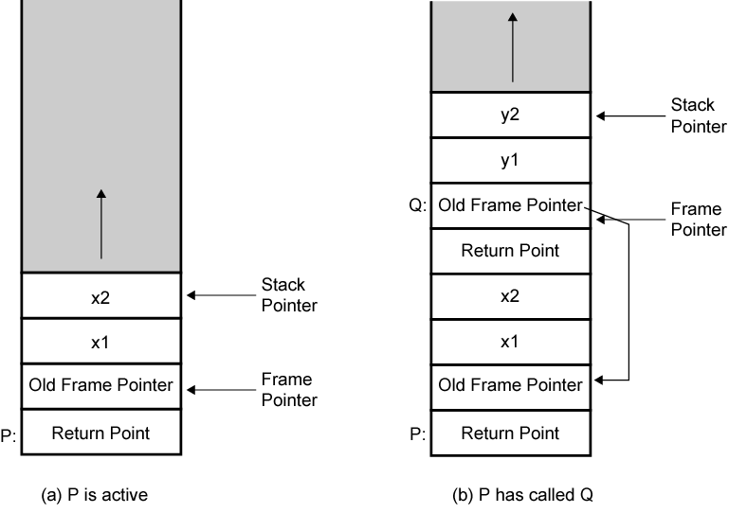
Stack Frame Growth Using Sample Procedures P and Q

Slide 35
Exercise For Reader
Find out about instruction set for Pentium and ARM
Start with Stallings
Visit web sites

Slide 36
Byte Order
(A portion of chips?)
What order do we read numbers that occupy more than one byte
e.g. (numbers in hex to make it easy to read)
12345678 can be stored in 4x8bit locations as follows
Notes:
27

Slide 37
Byte Order (example)
Address Value (1) Value(2)
184 12 78
185 34 56
186 56 34
186 78 12
i.e. read top down or bottom up?
Notes:
28

Slide 38
Byte Order Names
The problem is called Endian
The system on the left has the least significant byte in the lowest address
This is called big-endian
The system on the right has the least significant byte in the highest address
This is called little-endian
Notes:
29

Slide 39
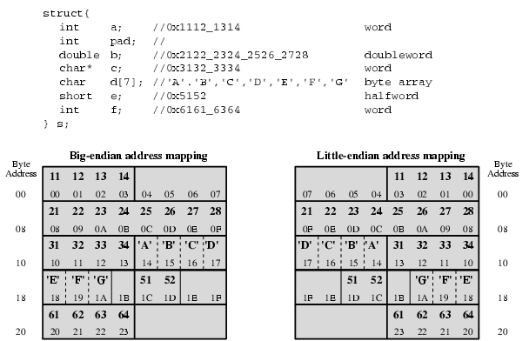
Example of C Data Structure

Slide 40
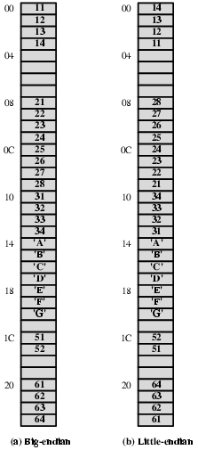
Alternative View of Memory Map

Slide 41
Standard…What Standard?
Pentium (x86), VAX are little-endian
IBM 370, Moterola 680x0 (Mac), and most RISC are big-endian
Internet is big-endian
  Makes writing Internet programs on PC more awkward!
  WinSock provides htoi and itoh (Host to Internet & Internet to Host) functions to convert
Notes:
30

